Slide 1
The Market at Work: Supply and Demand
3
Notes:
Pre-class music: “eBay” by Weird Al Yankovic (See Tip #087)
This song is a perfect example of how markets are supposed to function (by discussing the free market in terms of eBay, an online auction site that most people have used or at least know about, students better understand economic concepts such as “trade creates value” and “positive-sum games”).

Slide 2
Previously
“Scarcity” refers to the limited nature of society's resources.
The production possibilities frontier (PPF) is an illustration of the goods and services an economy is capable of producing.
Trade is mutually beneficial for both parties involved.

Slide 3
Big Questions
What are the fundamentals of markets?
What determines demand?
What determines supply?
How do supply and demand shifts affect a market?
Notes:
Lecture tip:
Understanding supply and demand allows students to
Predict changes in a market
How will the price of oranges respond to an early freeze in Florida?
Explain changes in a market
Why did the price of oranges increase last winter?
Understanding supply and demand will also help students understand how markets work. This will be important to future employers.

Slide 4
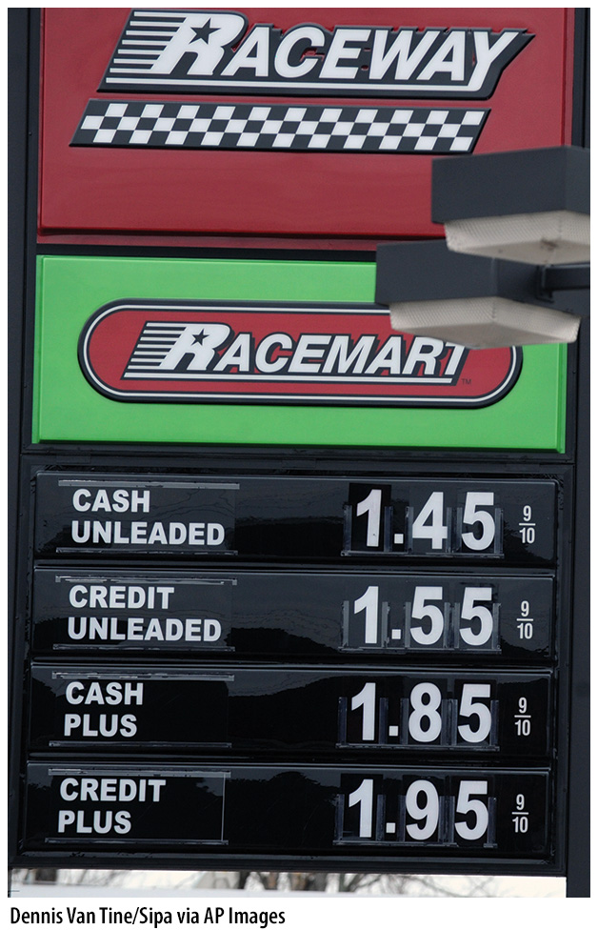
Here’s a question for you…
What factors affect the price of gasoline?
Notes:
Lecture notes:
While the gasoline market is not a competitive market, the conclusions that can be drawn through the supply and demand model
are still relevant.
The price of gasoline adjusts often and is one of the most visible prices to consumers every day. This is why it is useful to start the chapter with this example.
Ask students what factors they believe affect the price of gasoline. Some possible answers include
Demand
Ask students what they mean here; ask them to be more specific
Cost of production
Competition (number of sellers)
Some students may be aware of excise taxes on gasoline, especially if they have traveled across many states and have seen the price differences. Discuss this as a cost to the seller of selling a gallon of gas.
The major point here is to get students thinking about factors that affect both buyers and sellers. Build on these factors when discussing the determinants of demand and the determinants of supply.
[AP Photo/Reed Saxon, File]

Slide 5
Fundamentals of Markets—1
Firms
  Supply goods (or services)
Consumers
  Purchase goods supplied by firms
Exchange happens
  Through prices established in markets
  Supply or demand factors can change the market price
Notes:
Lecture notes:
There are two parties to every transaction: firms and consumers.
Recognize that students will more easily identify with the demand side of the market.
When you discuss supply, touch on the one market in which students have been a supplier (the labor market).
Indicate to students that we recognize that firms produce both goods and services, but for ease we will refer to just goods.
Refer to the discussion on gasoline prices when discussing that supply and demand factors both impact the market price.

Slide 6


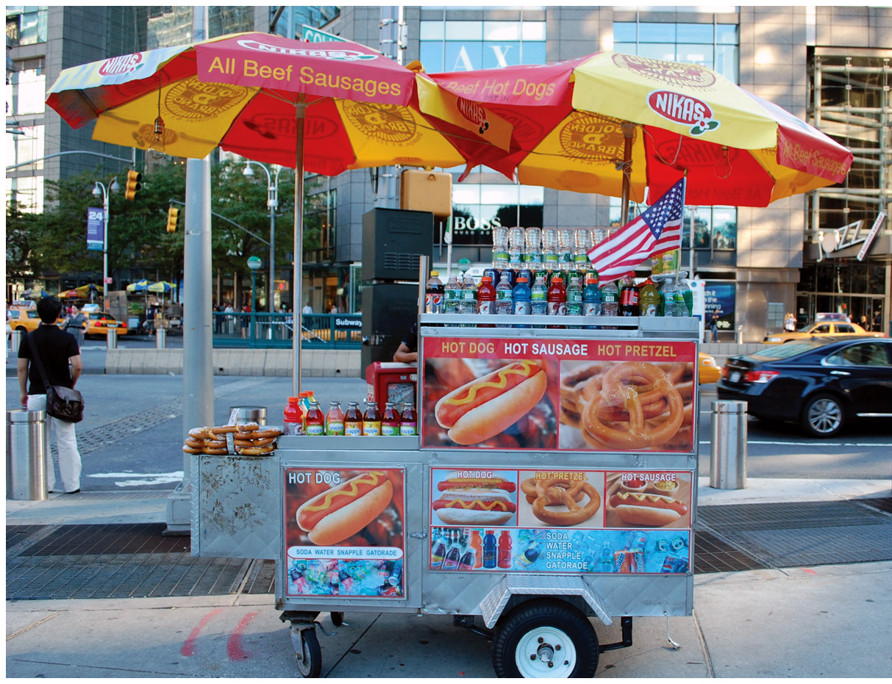
Fundamentals of Markets—2
Market
  Place where buyers and sellers meet
    Doesn’t have to be a physical place
Notes:
Lecture notes:
Markets exist whenever goods and services are exchanged.
Go through examples of markets; in each case, discuss how sellers and buyers find each other.
Stores
Flea markets/yard sales
Online stores (such as Amazon)
Bidding websites (such as eBay)
Classified ads sections of newspapers or Craigslist
Placement office at a university
[left: Maren Caruso/Photodisc/Getty Images; right: © Julie Feinstein | Dreamstime.com]

Slide 7
Fundamentals of Markets—3
Market economy
  Resources are allocated among households and firms with little or no government interference.
  Producers and consumers are motivated by self-interest.
The invisible hand of the market guides resources to their highest valued uses.
Notes:
Lecture notes:
Self-interest:
Producers want to sell products; consumers want to earn profits.
Consumers want to spend a limited budget on goods that make them happier.
The following Adam Smith quote will help exemplify the points above: “It is not from the benevolence of the butcher, the brewer or the baker that we expect our dinner, but from their regard to their own interest.” Follow up the quote by asking students to explain what they think Smith meant.

Slide 8
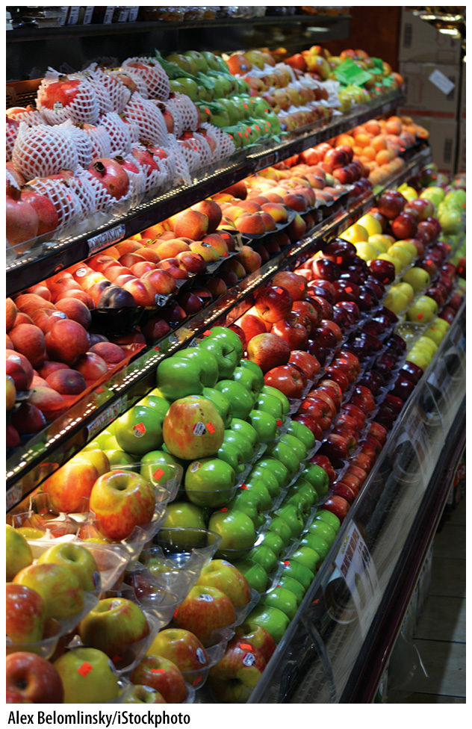
Competitive Markets
Characteristics of a competitive market:
  Many buyers and sellers
  The goods sold by each vendor are similar
  No one individual has any influence over the price
Notes:
Lecture tip:
The text considers a fish market as an example. We can do the same thing with the market for green apples:
Many buyers and sellers (generally hundreds)
Product sold is same across all sellers
One green apple is the same as the next; we cannot tell which orchard grew it
One farmer does not control the price but instead takes the market price as given
As an in-class exercise, set students up in the roles of farmers with apple trees. Suppose the price of one pound of apples is $1.00.
What will happen if Student A decides he or she wants to sell her apples for $1.50 per pound? How many apples will he or she sell?
Repeat this exercise, but now set the students up in the roles of buyers of apples.
What will happen if Student B isn’t willing to pay $1.00 per pound and is only willing to offer $0.75 per pound?
Reiterate that each seller and buyer is a very small fish in a very big pond. They will have no control over the price in the market and will have to take the price as given.
Informally introduce the term “price taker” to the students. When you discuss Chapter 9, remind them they heard this term before.
[© Johnfoto | Dreamstime.com]

Slide 9

Imperfect Markets
Imperfect market
  Buyer or seller has an influence on the price
Market power
  The firm’s ability to influence price
Monopoly
  A single company that supplies the entire market for a good or service
Notes:
Lecture notes:
An imperfect market is one that does not meet the conditions we just talked about with regard to perfect competition.
This means it may have
Few sellers or buyers
A product that is heterogeneous across sellers
In either of these cases, the seller has an ability to influence the price of the good.
Examples:
Fast food hamburgers
Airlines
Cars
Toothbrushes
At the extreme, there is a single firm producing a product with no real substitutes (a monopoly).
In the 1980s, De Beers had almost 90 percent of the rough diamond market (it is down below 30 percent now).
Make sure students understand that we will be assuming competitive markets when we discuss supply and demand, but the conclusions can tell us a lot about what happens in imperfectly competitive markets as well.

Slide 10
Demand—1
Quantity demanded
  The amount of a good buyers are willing and able to produce at the current price
Law of demand
  All else equal, there is an inverse relationship between price and quantity demanded
    If price ⬆, quantity demanded ⬇
    If price ⬇, quantity demanded ⬆
Notes:
Lecture notes:
Quantity demanded:
Explain to students that quantity demanded (QD) is an amount; it is a number.
Every price has a quantity demanded associated with it.
Inverse relationship between price and quantity demanded:
If price goes up, quantity demanded decreases; if price goes down, quantity demanded increases.
Lecture tip: Make sure students understand that everything else is being held constant here!

Slide 11
Demand—2
Demand schedule
  Table showing the relationship between price and quantity demanded
Demand curve
  Graph of the relationship between price and quantity demanded
Notes:
Lecture tip:
It is useful here to make sure that students recognize
“Demand” represents the relationship between price and quantity demanded
“Quantity demanded” is just one point in that relationship
Demand can be represented two ways:
Table (demand schedule)
Graph (demand curve)

Slide 12
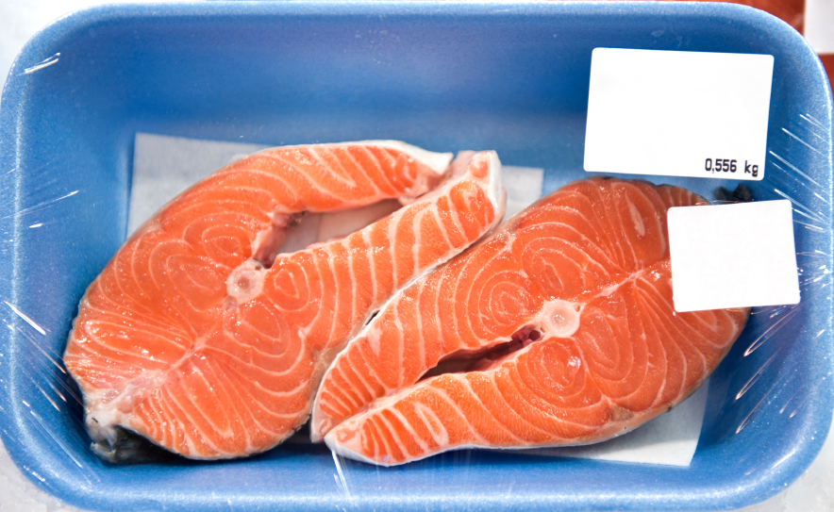
Demand Schedule
Ryan’s Demand Schedule for Salmon
Price of Salmon (per pound) | Pounds of Salmon Demanded
$20.00 | 0
$17.50 | 1
$15.00 | 2
$12.50 | 3
$10.00 | 4
$ 7.50 | 5
$ 5.00 | 6
$ 2.50 | 7
$ 0.00 | 8
Higher price
Lower quantity demanded
Higher quantity demanded
Lower price
Notes:
Lecture tip:
Point out to students that:
The entire table shows Ryan’s demand for salmon.
Each line in the table shows the quantity of salmon demanded by Ryan at a particular price.
This table assumes that nothing else is changing except price and quantity demanded.

Slide 13
Demand Curve
Notes:
Image: Animated Figure 3.1
Lecture tip:
Click through the slide to reveal the two missing labels.
Lecture notes:
The demand curve is a graph of the relationship between the prices on the demand schedule and the quantity demanded at those prices.
Each point on the demand curve represents the quantity demanded of the good at that price.
The entire curve shows the relationship.
The inverse relationship between price and the quantity demanded produces a downward-sloping curve:
As the price rises from $0 to $20 along the y axis, the quantity demanded decreases from eight to zero fillets along the x axis.
Make sure it is once again clear that this demand curve is drawn assuming that the only two things that are changing are price and quantity demanded.

Slide 14
Market Demand—1
Market demand
  Horizontal sum of all individual quantities demanded by each buyer in the market at each price

Slide 15
Market Demand—2
Price of Salmon |  | Ryan’s Demand |  | Melissa’s Demand |  | Market Demand
$20.00 |  | 0 |  | 0 |  | 0
$17.50 |  | 1 |  | 0 |  | 1
$15.00 |  | 2 |  | 1 |  | 3
$12.50 |  | 3 |  | 1 |  | 4
$10.00 |  | 4 |  | 2 |  | 6
$ 7.50 |  | 5 |  | 2 |  | 7
$ 5.00 |  | 6 |  | 3 |  | 9
$ 2.50 |  | 7 |  | 3 |  | 10
$ 0.00 |  | 8 |  | 4 |  | 12
+
=
Notes:
Lecture tip:
Click through to reveal the animation of + and =.
It often helps students to see this and hear it verbalized together: “At any price, we can add up Meredith’s and Derek’s quantity demanded to get the market quantity demanded.”
In order to make sure students fully understand, go through a few different prices.

Slide 16
Changes in Quantity Demanded versus Changes in Demand
Change in quantity demanded
  Movement along a demand curve
  Caused by a change in the price of the good
Change in demand
  Shift of the demand curve
    Entire demand curve will shift to the left or right
  Caused by changes in nonprice factors
Notes:
Lecture tip:
This is a very important distinction to make!
Again, return to these ideas:
Demand represents the relationship between price and quantity demanded (the entire table or curve).
Quantity demanded is just an amount at a particular price.
When the price of a good changes, we move to a new quantity demanded.
The relationship has not changed.
We’re just at a different point in the relationship.
When something other than price changes, we will have a new relationship.
Remind students that a demand schedule or demand curve assumes everything else is held constant other than price or quantity demanded.
If something other than price changes, the existing relationship between price and quantity demanded is no longer valid.
This is demonstrated by developing a new demand schedule or drawing a new demand curve.

Slide 17
Practice What You Know—1
P
Event:
The price of Oreos falls
A
$3
B
$2
D
4
5
Q (Oreos)
Notes:
Lecture tip:
The in-class quizzes in this chapter will really help reinforce graph concepts. It is best to go through these quizzes with students step by step.
Lecture notes:
First click:
Price of Oreos falls
Second click:
We see the movement along the curve from point A to point B.
Quantity demanded rises from 4 to 5.

Slide 18
Practice What You Know—2
P
Event:
The price of movie tickets increases
B
$20
A
$15
D
2
3
Q (movie tickets)
Notes:
Lecture notes:
First click:
Price of a movie ticket increases
Second click:
We see the movement along the curve from point A to point B.
Quantity demanded falls from three to two.

Slide 19
Changes in Demand
Notes:
Image: Animated Figure 3.3
Lecture notes:
First click:
Point out that the demand for cantaloupes is downward sloping because of the law of demand.
There’s an inverse relationship between price and quantity demanded.
Second click:
At a price of $5, six cantaloupes are demanded.
Point out that we could pick any price and find quantity demanded on the demand curve.
If the price changed to $4, we would move along the demand curve to the new quantity demanded (just point to where it would likely be).
Third click:
Start with a decrease in demand.
Suppose there is a health warning that causes buyers to want fewer cantaloupes.
What will happen?
People will want to buy fewer cantaloupes at any price.
Fourth click:
The new demand curve will lie to the left of the original demand curve.
At a price of $5, only three cantaloupes are demanded.
Note that at each price, the quantity demanded is now lower than before.
Fifth click:
Now, let’s talk about an increase in demand.
Suppose a new medical study concludes that eating cantaloupes lowers cholesterol.
What will happen?
People will want to buy more cantaloupes at any price.
Sixth click:
The new demand curve will lie to the right of the original demand curve.
At a price of $5, nine cantaloupes are now demanded.
Note that at each price, the quantity demanded is higher than before.
Make sure students understand that the demand curve is shifting “out” and “in” or “left” and “right,” “not “up” and “down” (it is quantity demanded that is changing at every price).

Slide 20
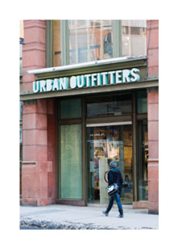
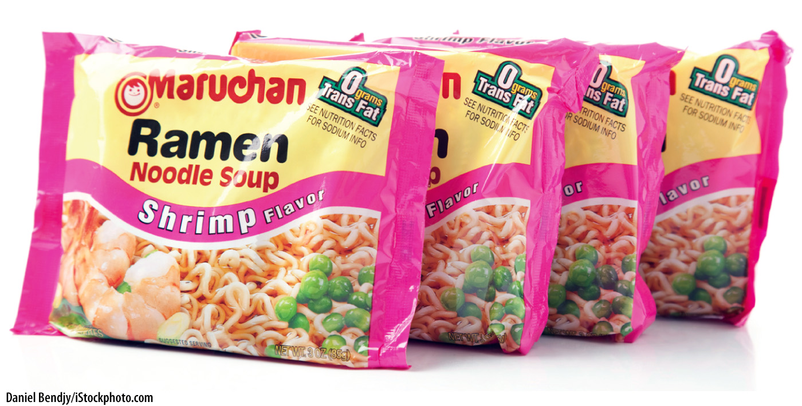
Factors that Shift Demand—1
Changes in income
Normal good
  Good we buy more of when we get more income
Inferior good
  Good we buy less of when we get more income
Notes:
Lecture tip:
As you go through each definition, here are a few things to point out to students:
Most goods are normal goods. When our income rises, we want more of most things.
What is a normal or inferior good for one person may not be the same for another person. It depends on the person’s tastes or preferences.
It could be useful to tell students that you will always indicate if the good in question is an inferior good; otherwise, they should assume it’s normal.
Wealth is also a useful thing to discuss.
Wealth is a stock variable, while income is a flow variable.
The demand for large-ticket items such as cars, boats, and so on may depend as much on wealth as on income.
Ask students to name some examples of normal and inferior goods. Here are some suggestions:
Normal goods:
Steak
Housing
Laptops
TVs
Sit-down restaurant meals
Name-brand clothing
Inferior goods:
Canned meat (SPAM)
Ramen
Mac and cheese
Store-brand goods or generics
Secondhand clothing or furniture
Suggested video clips: Family Guy, “Death Has a Shadow” (See Tip #103)
[left: Daniel Bendjy/iStockphoto.com; right: © Jen Grantham/iStockphoto.com]

Slide 21
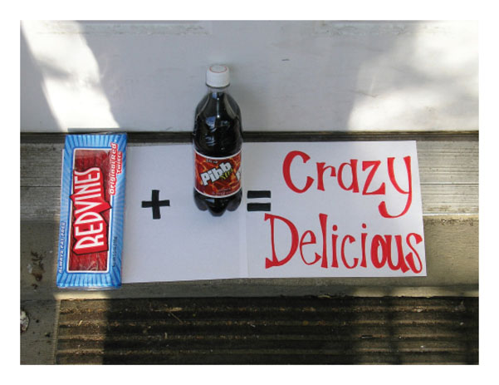
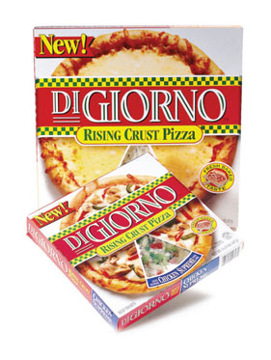

Factors that Shift Demand—2
2. Price of related goods
Complements
  Two goods used together
Substitutes
  Goods that can be used in place of each other
Notes:
Lecture tip:
As you go through each definition, here are a few things to point out to students:
Students should always work through the story to see what happens to demand.
For example: Suppose an individual always consumes Red Vines and Mr. Pibb together. If the price of Red Vines increases,
The quantity of Red Vines demanded will fall.
If the individual is consuming fewer Red Vines, he or she will want to consume less Mr. Pibb.
The demand for Mr. Pibb will fall.
Trying to memorize these effects is just confusing. The story will always lead to the right answer.
For example, if the price of DiGiorno pizza falls,
The quantity of DiGiorno pizzas demanded will rise.
If the individual is consuming more DiGiorno pizzas, he or she will want to buy fewer store-brand pizzas.
The demand for store-brand pizzas will fall.
Ask your students to name some examples of complements and substitutes. Here are some suggestions:
Complements:
Biscuits and gravy
Milk and cereal
Printers and toner
Peanut butter and jelly
Tennis rackets and tennis balls
Substitutes:
Coke and Pepsi
Snickers and Milky Way
Butter and margarine
Pizza Hut and Domino’s
Suggested reading: An interesting article about substitutes for students to read is Bonello, Deborah. (December 30, 2015). “Mexican marijuana farmers see profits tumble as U.S. loosens laws.” Los Angeles Times. Retrieved from http://www.latimes.com/world/mexico-americas/la-fg-mexico-marijuana-20151230-story.html.
[bottom left: BOB FILA AND JAMES F. QUINN KRT/Newscom; bottom right: © Jeff Greenberg / Alamy]

Slide 22
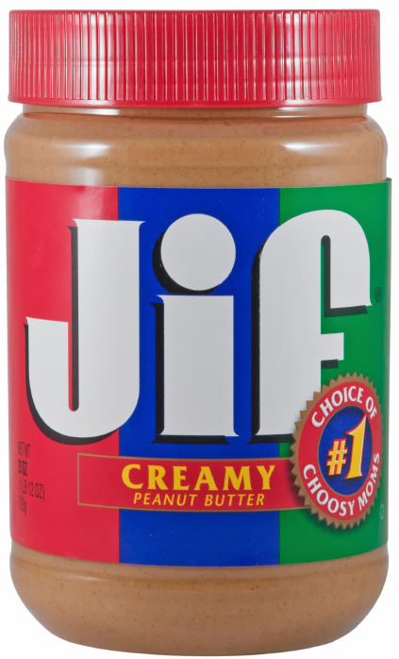
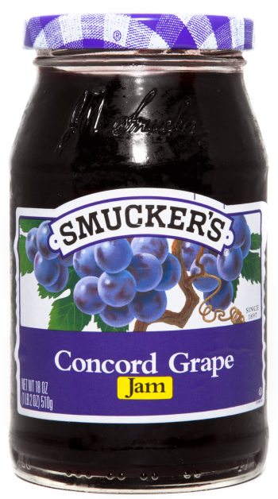
Prices of Related Goods
Event: Price of peanut butter increases
Peanut butter:
Movement along the demand curve
Jelly:
A shift in demand
P
P
B
$4
A
$3
D
D₂
D₁
2
4
Q
Q
Notes:
“Beyond the Book” Slide
Lecture notes:
When the price of peanut butter increases, there is a decrease in the quantity demanded for peanut butter (a movement along the peanut butter demand curve). This is the first law of demand.
Ask students what type of relationship exists between peanut butter and jelly.
Complements
Since we are consuming less peanut butter, we are consuming less jelly also, even though the price of jelly didn’t change. The demand for jelly decreases (jelly demand curve shifts left).

Slide 23
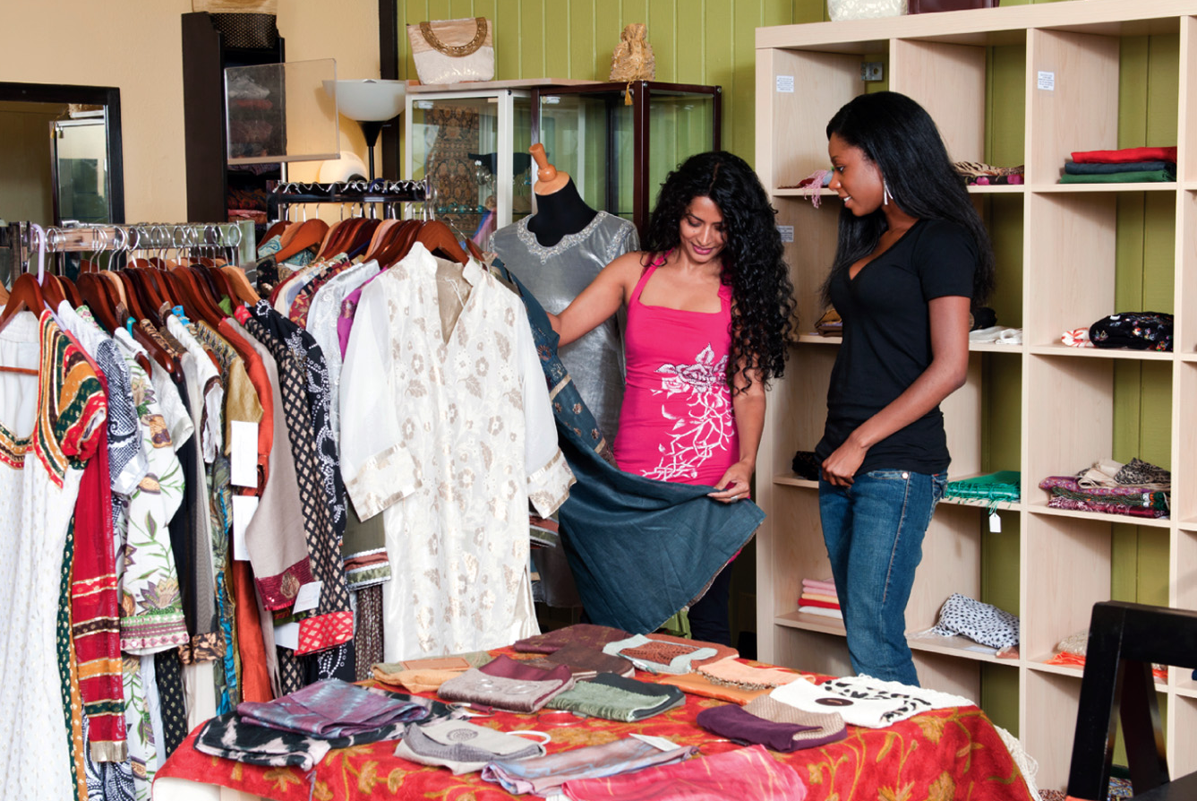
Factors that Shift Demand—3
3. Changes in Tastes and Preferences
A good may become more fashionable or may go out of style
A good may come into or go out of season
Notes:
[© Eliza Snow/iStockphoto.com]

Slide 24
Factors that Shift Demand—4
4. Price expectations
  Our consumption today may depend on what we think the price may be tomorrow
5. Number of buyers
  More individual buyers means more market demand
Taxes
  Excise taxes raise the cost to consumers
Notes:
Lecture notes:
Price Expectations: You can start the discussion on price expectations by asking students the following question: Are you planning to get gas today?
Choose the students who are not and present them with the following scenario:
On the way to school, you hear a news story on the radio that indicates that the price of gas is going up $1.00 per gallon at midnight tonight.
What will you do today?
Point out that just the expectation that the price will change has altered their demand for gasoline (it makes no difference if the news story is correct or not).
Now, reverse it for those who already planned to get gas today:
On the way to school, you hear a news story on the radio that indicates that the price of gas is going to fall by $1.00 per gallon at midnight tonight.
Will you fill up your tank today?
Again, point out that just the expectation that the price will change has altered their demand for gasoline (it makes no difference if the news story is correct or not).
Number of Buyers:
Remind students that the market demand curve is the sum of all individual demand curves.
Therefore, market demand will increase when more individual buyers enter the market.
If your college or university is in a “college town” and the population in town is greatly affected by the school, it’s a good idea to discuss the demand for goods and services (restaurants, bars, etc.) from August to May and then in the summer.
Taxes:
Some goods in our economy have excise taxes (tobacco, gasoline, alcohol). These taxes make the goods more expensive for consumers and therefore reduce demand.

Slide 25
Practice What You Know—3
Event:
The price of a Burger King Whopper falls
P
D₁
D₂
Q (Big Macs)
Notes:
Lecture notes:
First click:
The price of a Burger King Whopper falls.
Make sure to point out that this is the demand for Big Macs.
Ask students what the relationship is between Whoppers and Big Macs (substitutes).
The price of a Whopper falls. What happens to the quantity demanded of Whoppers?
People buy more Whoppers.
What happens to the demand for Big Macs?
Second click:
We see the shift from D₁ to D₂.
Demand decreases.

Slide 26
Practice What You Know—4
Event:
You get a pay raise at your job
P
D₁
D₂
Q (steak dinners)
Notes:
Lecture notes:
First click:
There is an increase in income.
What happens to the amount of steak dinners you want to buy?
Demand will increase.
Second click:
We see the shift from D₁ to D₂.
Demand rises.
Make sure to ask students what assumption they are making about the type of good we are talking about here (normal good).

Slide 27
Practice What You Know—5
Event:
You get a pay raise at your job
P
D₁
D₂
Q (generic cheese)
Notes:
Lecture notes:
First click:
There is an increase in income.
What happens to the amount of generic cheese you want to buy?
Demand will fall.
Second click:
We see the shift from D₁ to D₂.
Demand falls.
Make sure to ask students what assumption they are making about the type of good we are talking about here (inferior good).

Slide 28
Practice What You Know—6
Event:
The price of your favorite beverage falls
P
D₁
D₂
Q (pizza)
Notes:
Lecture notes:
First click:
Suppose that the price of your favorite beverage (soda, beer, milk, juice, water, etc.) falls.
What happens to the amount of that beverage you purchase?
It rises.
Point out that this is an increase in quantity demanded.
Now, suppose you always eat pizza when you drink your favorite beverage.
What type of goods are these?
What happens to the amount of pizza you want to buy?
Demand will rise.
Second click:
We see the shift from D₁ to D₂.
Demand rises.
Reinforce that the change in the price of the beverage causes a change in the quantity of the beverage demanded but also a change in the demand for pizza.

Slide 29
Practice What You Know—7
Event:
Doctors discover that oranges cure baldness
P
D₁
D₂
Q (oranges)
Notes:
Lecture notes:
First click:
Doctors discover that eating oranges cures baldness.
What happens to the amount of oranges people will want to buy?
Demand will rise.
Second click:
We see the shift from D₁ to D₂.
Demand rises.

Slide 30

Practice What You Know—8
The following three questions are considering the market for the same good:
PEPSI
We are considering:
  Change in quantity demanded (movement)
  Change in demand (shift)
Notes:
Lecture tip:
The quiz is designed to see if the students understand if an event will cause a movement or shift with demand for a good.

Slide 31
Practice What You Know—8.1
Assume you like Pepsi and your income increases.
The demand for Pepsi increases.
The demand for Pepsi decreases.
The quantity demanded of Pepsi increases.
The quantity demanded of Pepsi decreases.
Notes:
Clicker question:
Correct answer: A, The demand for Pepsi increases.
Normal good = outward shift in demand

Slide 32
Practice What You Know—8.2
Assume the price of Pepsi decreases.
The demand for Pepsi increases.
The demand for Pepsi decreases.
The quantity demanded of Pepsi increases.
The quantity demanded of Pepsi decreases.
Notes:
Clicker question:
Correct answer: C, The quantity demanded of Pepsi increases.
Movement along a stable demand curve; movement down and to the right

Slide 33
Practice What You Know—8.3
Assume the price of Coke decreases.
The demand for Pepsi increases.
The demand for Pepsi decreases.
The quantity demanded of Pepsi increases.
The quantity demanded of Pepsi decreases.
Notes:
Clicker question:
Correct answer: B, The demand for Pepsi decreases.
Coke and Pepsi are substitutes. Coke becomes cheaper, so we buy more Coke; if we buy more Coke, we buy less Pepsi.

Slide 34
Practice What You Know—9
Suppose the price of good X increases. In terms of demand, what is the result?
  The demand for X increases.
  The demand for X decreases.
  The quantity demanded of X increases.
  The quantity demanded of X decreases.
Notes:
Clicker question:
Correct answer: D, The quantity demanded of X decreases.
This is a movement up and left along a demand curve. Price is on the vertical axis, and quantity demanded is on the horizontal axis.

Slide 35
Practice What You Know—10
Suppose goods X and Y are substitutes for each other. If the price of good Y increases, what is the result in the market for good X?
  The demand for X increases.
  The demand for X decreases.
  The quantity demanded of X increases.
  The quantity demanded of X decreases.
Notes:
Clicker question:
Correct answer: A, The demand for X increases.
This is a rightward shift in the demand for X. People want to buy more X, even though the price of X didn’t change.

Slide 36
Class Activity: Think-Pair-Share
You work at a restaurant/bar.
  Your boss comes to you, knowing you are studying economics, and asks for your opinion on the following question:
Which of the following would increase the demand for drinks the most?
  a reduction in the price of a complementary good such as an appetizer
  a reduction in the price of drinks
  both
Think carefully about your answer for a minute. Pair up with a classmate and share your thoughts.
Notes:
Lecture notes:
Classroom activity: Ask students to pair up and consider the scenario presented on the slide (see the Think-Pair-Share Activity in the Interactive Instructor’s Guide, Tip #096).
Answer:
Prompt students to think about the difference between the following:
Increase in demand
Increase in quantity demanded
If you want to increase demand, you need to cause a shift in demand; this is done by reducing the price of the complement goods. If you decrease the price of drinks, this is an increase in quantity demanded, not an increase in demand.

Slide 37
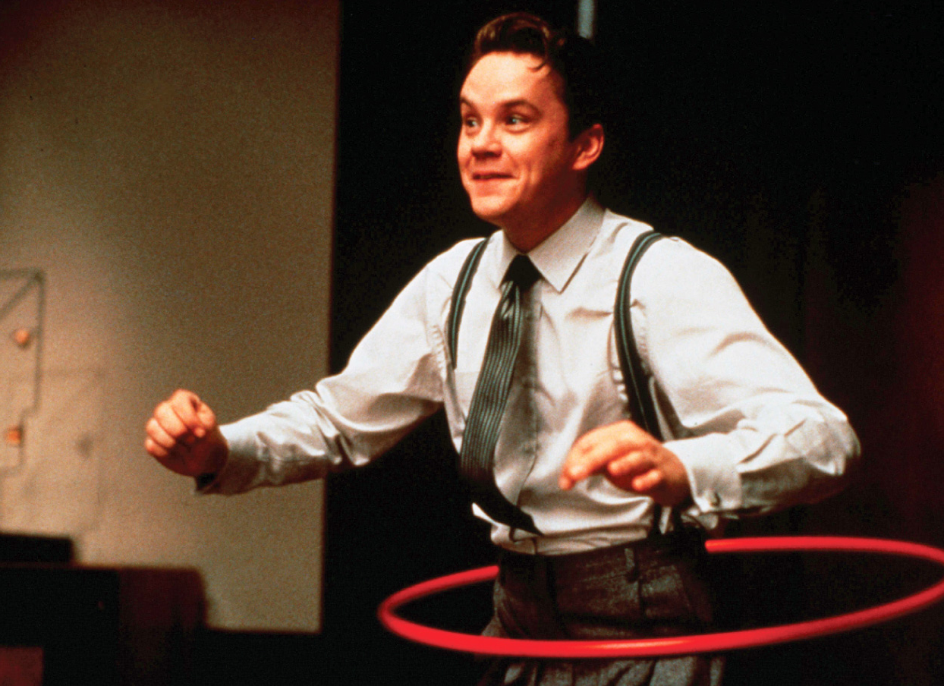
Economics in The Hudsucker Proxy
The Hudsucker Proxy (1994)
  Watch for changes in price. Which price changes are an illustration of a movement along a demand curve, and which are the result of demand increase?
Notes:
“Economics in the Media” Slide
Lecture tip:
The clip mentioned on the slide can be found in the Interactive Instructor’s Guide. Access the direct link by clicking the icon in the PowerPoint.
Summary:
At first, the clip shows moving along a demand curve by lowering price. However, there’s still no effect since the Hula-hoop seems to be unpopular.
Then, after a boy finds discarded Hula-hoops, popularity (and demand) of Hula-hoops increases. This causes the demand curve to keep shifting outward, resulting in higher prices.
After showing the clip, ask students why the shopkeeper was lowering price. What was his hope?
He hoped that if he reduced the price, quantity demanded would increase.
Now, ask what happens after the little boy finds the Hula-hoop and demonstrates it.
The kids all wanted one; this is a change in tastes/preferences and demand increases.
Make sure to draw the distinction between the change in quantity demanded (movement along the curve) and the change in demand (shift in the curve).
[POLYGRAM/WARNERS/SILVER PICTURES/THE KOBAL COLLECTION/JAMES BRIDGES/Art Resource, NY]

Slide 38
Supply—1
Quantity supplied
  The amount of the good or service that producers are willing and able to sell at the current price
Law of supply
  All else equal, there is a direct relationship between price and quantity supplied
    If price ⬇, quantity supplied ⬇
    If price ⬆, quantity supplied ⬆
Notes:
Lecture tip:
Many supply topics are analogous to demand. Thus, you may not have to spend as much time teaching supply.
Quantity supplied:
Explain to students that quantity supplied (QS) is an amount; it is a number.
Every price has a quantity supplied associated with it.
Direct relationship between price and quantity supplied:
If price goes up, quantity supplied increases.
If price goes down, quantity supplied decreases.
Make sure students understand that everything else is being held constant here.
o students that quantity supplied (QS) is an amount; it is a number.
Every price has a quantity supplied associated with it.
Direct relationship between price and quantity supplied:
If price goes up, quantity supplied increases.
If price goes down, quantity supplied decreases.
Make sure students understand that everything else is being held constant here!

Slide 39
Supply—2
Supply schedule
  Table showing the relationship between price and quantity supplied
Supply curve
  Graph of the relationship between price and quantity supplied
Notes:
Lecture tip:
Here, it is useful to make sure that students recognize the following:
“Supply” represents the relationship between price and quantity supplied.
“Quantity supplied” is just one point in that relationship.
Supply can be represented two ways:
Table (supply schedule)
Graph (supply curve)

Slide 40
Supply—3
Pure Food Fish’s Supply Schedule
Price of Salmon (per pound) | Pounds of Salmon Supplied
$20.00 | 800
$17.50 | 700
$15.00 | 600
$12.50 | 500
$10.00 | 400
$ 7.50 | 300
$ 5.00 | 200
$ 2.50 | 100
$ 0.00 | 0
Higher price
Higher quantity supplied
Lower quantity supplied
Lower price
Notes:
Lecture tip:
Point out to students that:
The entire table shows Pure Food Fish’s supply of salmon.
Each line in the table shows the quantity of salmon supplied by Pure Food Fish at a particular price.
This table assumes that nothing else is changing except price and quantity supplied.

Slide 41
Market Supply—1
Market supply
  Horizontal sum of all individual quantities supplied by each seller in the market at each price
Notes:
Lecture notes:
Analogous to demand:
There are many ways to convey information.
Supply schedule: table
Supply curve: graph
We can also use math and equations.
Market supply: This is just adding up the supply of all potential sellers of the good.

Slide 42
Market Supply—2
Price of Salmon |  | Pure Food Fish’s Supply |  | City Fish’s Supply |  | Market Supply
$20.00 |  | 800 |  | 200 |  | 1000
$17.50 |  | 700 |  | 175 |  | 875
$15.00 |  | 600 |  | 150 |  | 750
$12.50 |  | 500 |  | 125 |  | 625
$10.00 |  | 400 |  | 100 |  | 500
$ 7.50 |  | 300 |  | 75 |  | 375
$ 5.00 |  | 200 |  | 50 |  | 250
$ 2.50 |  | 100 |  | 25 |  | 125
$ 0.00 |  | 0 |  | 0 |  | 0
+
=
Notes:
Lecture tip:
Click through to reveal the animation of + and =.
It often helps students to see this and hear it verbalized together: “At any price, we can add up Pure Food Fish’s and City Fish’s quantity supplied to get the market quantity supplied.”
Go through a few different prices to make sure students understand.

Slide 43
Changes in Quantity Supplied versus Changes in Supply
Change in quantity supplied
  Movement along a supply curve
  Caused by a change in the price of the good
Change in supply
  Shift in the supply curve
    Entire supply curve will shift to the left or right
  Caused by a change in nonprice factors
Notes:
Lecture tip:
This is a very important distinction to make!
Again, return to these ideas:
Supply represents the relationship between price and quantity supplied (the entire table or curve).
Quantity supplied is just an amount at a particular price.
When the price of a good changes, we move to a new quantity supplied.
The relationship has not changed.
We’re just at a different point in the relationship.
When something other than price changes, we will have a new relationship.
Remind students that a supply schedule or supply curve assumes everything else is held constant other than price or quantity supplied.
If something other than price changes, the existing relationship between price and quantity supplied is no longer valid.
This is demonstrated by developing a new supply schedule or drawing a new supply curve.

Slide 44
Changes in Supply
Notes:
Image: Animated Figure 3.7
Lecture notes:
First click:
Point out that the supply of coffee is upward sloping because of the law of supply.
There’s a direct relationship between price and quantity supplied.
Second click:
At a price of $3, Q₁ cups of coffee are supplied.
Point out that we could pick any price and find quantity supplied on the supply curve.
If the price changed to $4, we would move along the supply curve to the new quantity supplied (just point to where it would likely be).
Third click:
Start with a decrease in supply.
Suppose there is a hurricane that destroys the Colombian coffee crop.
What will happen?
Sellers will be willing to sell less coffee at any price.
Fourth click:
The new supply curve will lie to the left of the original supply curve.
At a price of $3, only Q₃ cups of coffee are supplied.
Note that at each price, the quantity supplied is now lower than before.
Fifth click:
Now, let’s talk about an increase in supply.
Suppose a new way to brew coffee is created that cuts in half the cost of producing a cup of coffee.
What will happen?
Producers will want to sell more cups of coffee at any price.
Sixth click:
The new supply curve will lie to the right of the original supply curve.
At a price of $3, Q₂ cups of coffee are now supplied.
Note that at each price, the quantity supplied is higher than before.
Make sure students understand that the supply curve is shifting “out” and “in” or “left” and “right.” Do not let them think it is shifting “up” and “down” (it is quantity supplied that is changing at every price).

Slide 45
Factors that Shift Supply—1
1. The cost of inputs
Inputs
  Resources used in the production process
2. Changes in technology
Technology
  Knowledge that producers have about how to produce a product
Notes:
Lecture notes:
Anything that affects the cost of production will impact supply.
Costs of inputs
Technology
Taxes and subsidies
Increase in the cost of production reduces profit per unit (all else equal), making producers less interested in selling the product.
Inputs:
Ask students to provide examples of production inputs. Here are some examples:
Labor
Raw materials
Electricity
Machinery
Technology:
Make sure to discuss the definition; many students think of machinery as technology, but it really is just knowledge. We assume that all technology reduces the cost of production (otherwise you wouldn’t use it).

Slide 46
Factors that Shift Supply—2
3. Taxes and subsidies
Tax
  Tax paid by producer → added cost of production
Subsidy
  “Opposite” of a tax; government pays sellers to produce goods
    Reduces the cost of production
Notes:
Lecture tip:
Students probably already know the definition of a tax, but they may not have heard of a subsidy. Think of a subsidy as the opposite of a tax. Instead of paying the government, a subsidy is when the government pays the firm.
Taxes increase the cost of production and reduce supply.
Subsidies reduce the cost of production and increase supply.

Slide 47
Factors that Shift Supply—3
4. Number of sellers
  More individual sellers means more market supply
5. Price expectations
  Higher price expected tomorrow? If so, delay sales until future if possible
Notes:
Lecture notes:
Number of Sellers:
Remind students that the market supply curve is the sum of all individual supply curves.
Therefore, market supply will increase when more sellers enter the market and will decline when sellers exit the market.
Price Expectations:
Give the students a scenario (unrealistic is fine) and ask them how they will behave:
“Suppose you happen to own land that contains a great deal of oil. If you think the future price of oil is higher than the price today, how might that affect your decision to pump it out and sell it today? In other words, how does it affect your supply of oil today?”
Make sure students realize that this isn’t possible for all goods (especially goods that will spoil).
Point out that just the expectation that the price will change has altered their supply of oil (it makes no difference if the expectation is correct or not).

Slide 48
Practice What You Know—11
Assume the price of cheese decreases. What will happen in the pizza market?
The supply of pizza increases.
The supply of pizza decreases.
The quantity supplied of pizza increases.
The quantity supplied of pizza decreases.
Notes:
Clicker question:
Correct answer: A, The supply of pizza increases.
Cheese is an input in making pizza.
If input costs of pizza go down, the supply of pizza increases.
Point out to students that an increase in the price of cheese will reduce the quantity demanded of cheese.
But, the price of cheese is a nonprice factor for the supply of pizza.
[© Jeff Greenberg / Alamy]

Slide 49
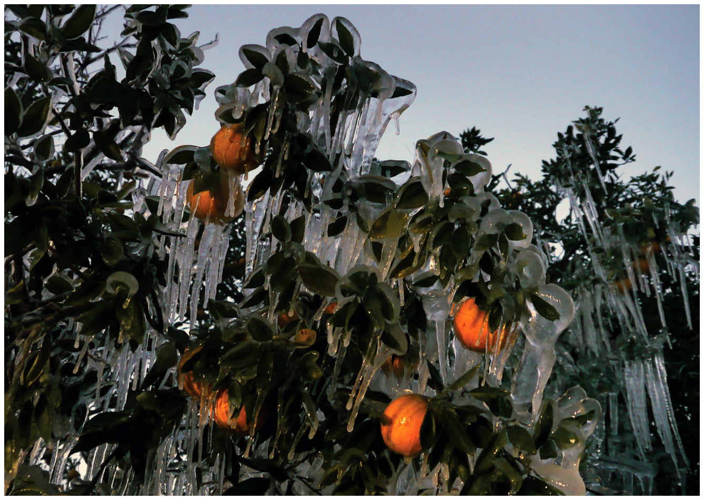
Practice What You Know—12
Which of the following will
cause the supply curve for
oranges to shift to the left?
The government begins subsidizing orange growers.
A study is released showing oranges improve eyesight.
An ice storm strikes Florida.
A new orange juice commercial airs on TV.
Notes:
Clicker question:
Correct answer: C, An ice storm strikes Florida.
An ice storm will decrease the number of firms supplying oranges. It may destroy most of their crop.
Answers B and D will increase demand for oranges, while answer A will increase supply

Slide 50
Practice What You Know—13
Which of the following will most likely cause a decrease in the supply of most fruits and vegetables?
  an increase in demand for meat
  the introduction of an environmentally friendly pesticide
  a decrease in the price of corn and rice
  harsh punishments for farmers who hire undocumented workers
Notes:
Clicker question:
Correct answer: D, harsh punishments for farmers that hire undocumented workers
Low-skilled labor is a major input in the production and harvesting of fruits and vegetables. If we restrict low-skilled labor by having harsh immigration laws, there may be one of two results:
The fruit and vegetable harvest gets done by higher-paid domestic workers, which raises production costs.
The harvesting jobs will not be completed if no workers are found willing to do the job, which will decrease the supply of fruits and vegetables.

Slide 51
Bringing Supply and Demand Together
How is the price of a good determined?
  Through the market forces of supply and demand
Law of supply and demand
  The market price of any good will adjust to bring the quantity supplied and quantity demanded into balance
Notes:
Lecture notes:
So far, we have examined supply and demand have been separately. Now we will see how the two interact. The real power and potential of supply and demand analysis is how it predicts prices and output in the entire market.
Think about scissors cutting a piece of paper. Which blade does the cutting?
Both blades work together to cut the paper.

Slide 52
Supply and Demand—1
Equilibrium price
  The price at which quantity supplied is equal to quantity demanded
  The price that “clears the market”
Equilibrium quantity
  The quantity at which quantity demanded is equal to quantity supplied
Notes:
Lecture notes:
Equilibrium means that there is no force that will cause change.
At the market equilibrium:
All buyers can find sellers.
All sellers can find buyers.
Everyone is happy.
Make sure students understand that this occurs at the intersection of the demand and supply curves, but make sure to also emphasize why this is where the equilibrium is.

Slide 53
Shortages and Surpluses—1
Shortage
  Occurs when Q_{D} > Q_{S}
  Occurs at any price below equilibrium
    Price will rise over time toward equilibrium
Why does price rise over time with a shortage?
  Consumers will “outbid” other consumers
Notes:
Lecture notes:
Q_{D} = quantity demanded
Q_{S} = quantity supplied
When you have a shortage:
Some buyers can’t find sellers.
Buyers will bid the price up to compete for a limited amount.
Sellers will respond to price increase.
As the price rises toward equilibrium:
Quantity demanded falls (law of demand).
Quantity supplied rises (law of supply).
This continues until the market gets to equilibrium.

Slide 54
Shortages and Surpluses—2
Surplus
  Occurs when Q_{S} > Q_{D}
  Occurs at any price above equilibrium
    Price will fall over time toward equilibrium
Why does price fall over time with a surplus?
  Firms will lower prices to get rid of mounting inventories
Notes:
Lecture notes:
Q_{D} = quantity demanded
Q_{S} = quantity supplied
When you have a shortage:
Some sellers can’t find buyers.
Sellers will drop the price to get rid of inventories.
Buyers will respond to the price decrease.
As the price falls toward equilibrium:
Quantity demanded rises (law of demand).
Quantity supplied falls (law of supply).
This continues until the market gets to equilibrium.

Slide 55
Supply and Demand—2
Notes:
Image: Animated Figure 3.9
Lecture tip:
Make sure to go over this graph thoroughly with students.
Lecture notes:
First click:
The equilibrium occurs where quantity supplied is equal to quantity demanded.
This occurs at a price of $10.
Note that at a price of $19 = 0, quantity demanded is equal to 500 and quantity supplied is also equal to 500.
Second click:
What if the price is $5?
Quantity demand now equals 750.
Quantity supplied is equal to 250.
Third click:
Q_{D} > Q_{S}, so we have a shortage.
The shortage is equal to 750 – 250 = 500 units.
Fourth click:
Over time, buyers who can’t find salmon will bid the price up.
As the price rises, quantity demanded will fall (movement along the demand curve).
As the price rises, quantity supplied will rise (movement along the supply curve).
This continues until we get to equilibrium at a price of $10 and a quantity of 500.
Fifth click:
What if the price is $15?
Quantity demanded is 250.
Quantity supplied is 750.
Sixth click:
Q_{D} < Q_{S}, so we have a surplus.
The surplus is equal to 750 - 250 = 500 units.
Seventh click:
Over time sellers will reduce the price to get rid of their inventory.
As the price falls, quantity demanded will rise (movement along the demand curve).
As the price falls, quantity supplied will fall (movement along the supply curve).
This continues until we get to equilibrium at a price of $10 and a quantity of 500.

Slide 56
Economics in Pawn Stars
Pawn Stars (History Channel)
  Bartering is a great way to see the forces of supply and demand at work.
Notes:
“Economics in the Media” Slide
Lecture tip:
The clip mentioned on the slide can be found in the Interactive Instructor’s Guide. Access the direct link by clicking the icon in the PowerPoint.

Slide 57
Practice What You Know—14
Suppose there is a shortage in the market for avocados. Assuming a competitive and unrestrained market, what happens over time?
  The price of avocados will fall, and the shortage will worsen.
  The price of avocados will rise, and the market will eventually reach equilibrium.
  The price of avocados will rise, and a large surplus will be created.
  Producers will stop growing avocados.
Notes:
Clicker question:
Correct answer: B, The price of avocados will rise, and the market will eventually reach equilibrium.
Without price controls, the market will correct itself and move toward equilibrium. A shortage is due to the price being too low. The price will rise to correct the shortage.

Slide 58
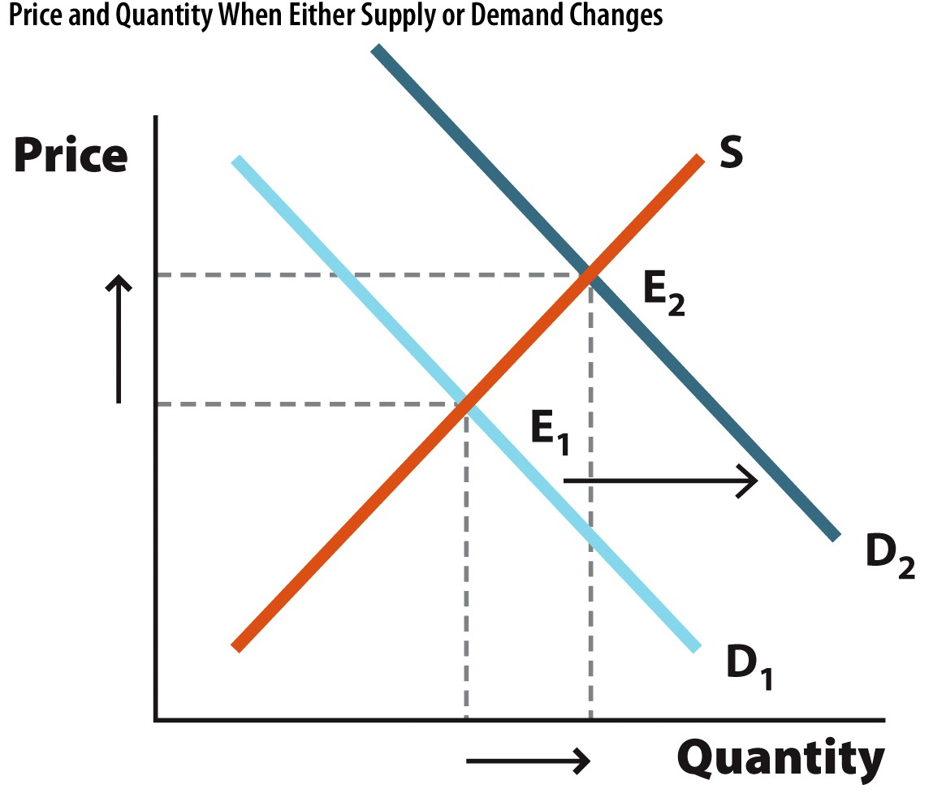
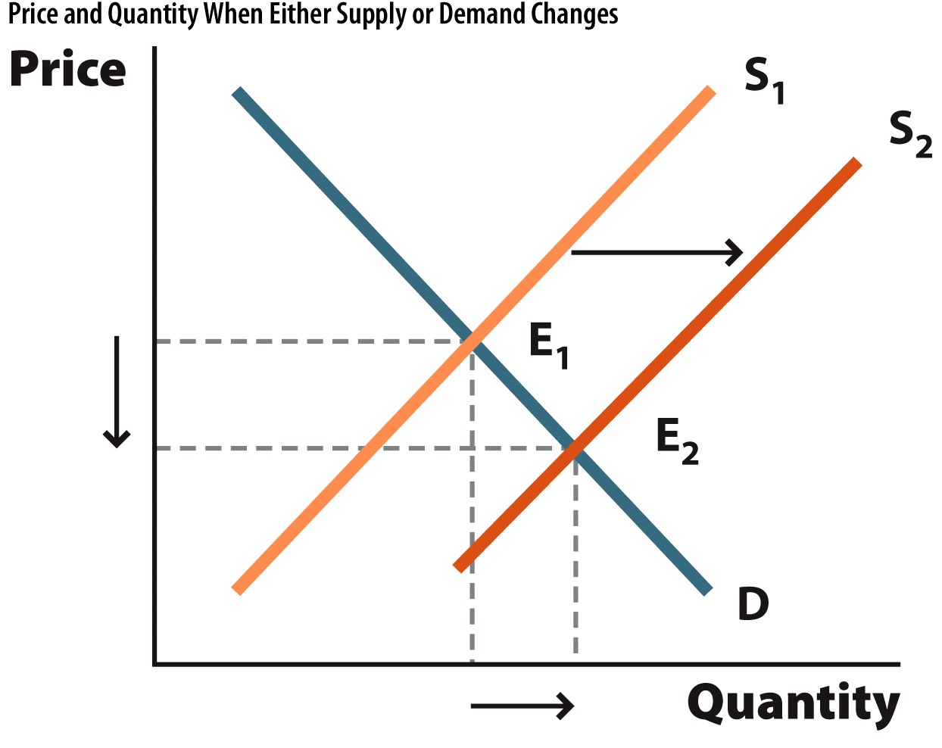
Graphs of Shifts—1
Change | Illustration | Impact on Price and Quantity
Demand increases |  | The demand curve shifts to the right. As a result, the equilibrium price and equilibrium quantity increase.
Supply increases |  | The supply curve shifts to the right. As a result, the equilibrium price declines and the equilibrium quantity increases.
Notes:
Image: Figure 3.10
Lecture tip:
Go through each of these diagrams thoroughly. For each one, make sure to tell the story of why the equilibrium price changes after the curve shifts. Encourage students to combine these graphs with a list of the factors that could lead to these shifts.
Demand increases:
The demand curve shifts to the right.
At the initial equilibrium price, a shortage exists.
This puts upward pressure on price.
As price rises, Q_{D} and Q_{S} adjust until we reach the new equilibrium.
Supply increases:
The supply curve shifts to the right.
At the initial equilibrium price, a surplus exists.
This puts downward pressure on price.
As price falls, Q_{D} and Q_{S} adjust until we reach the new equilibrium.

Slide 59
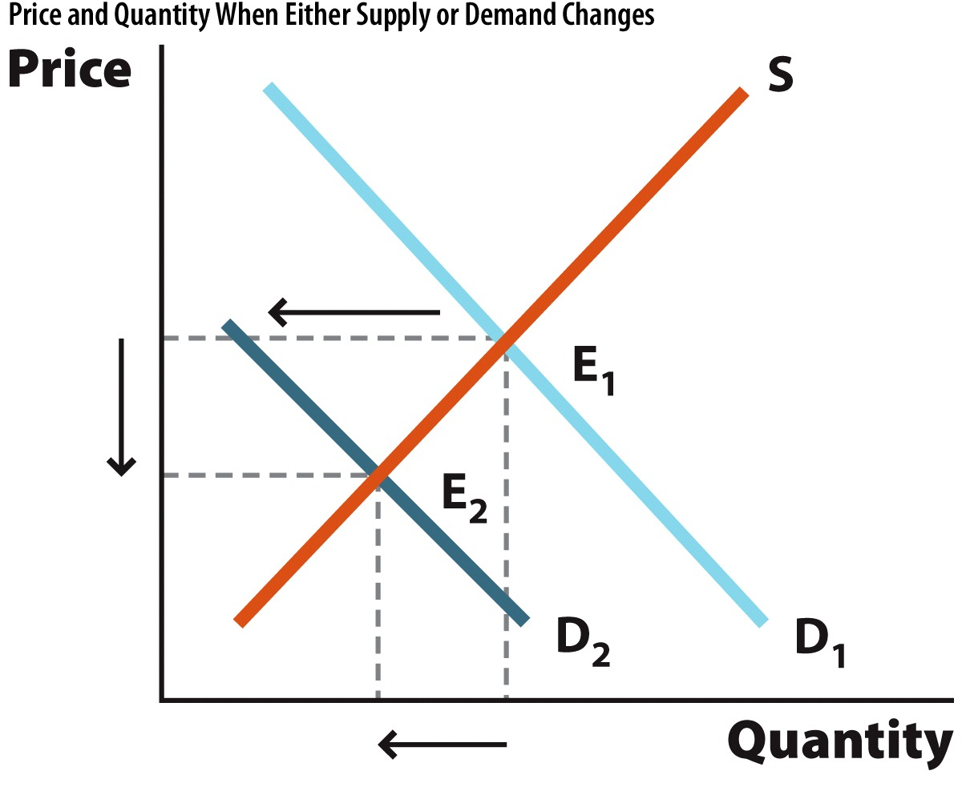
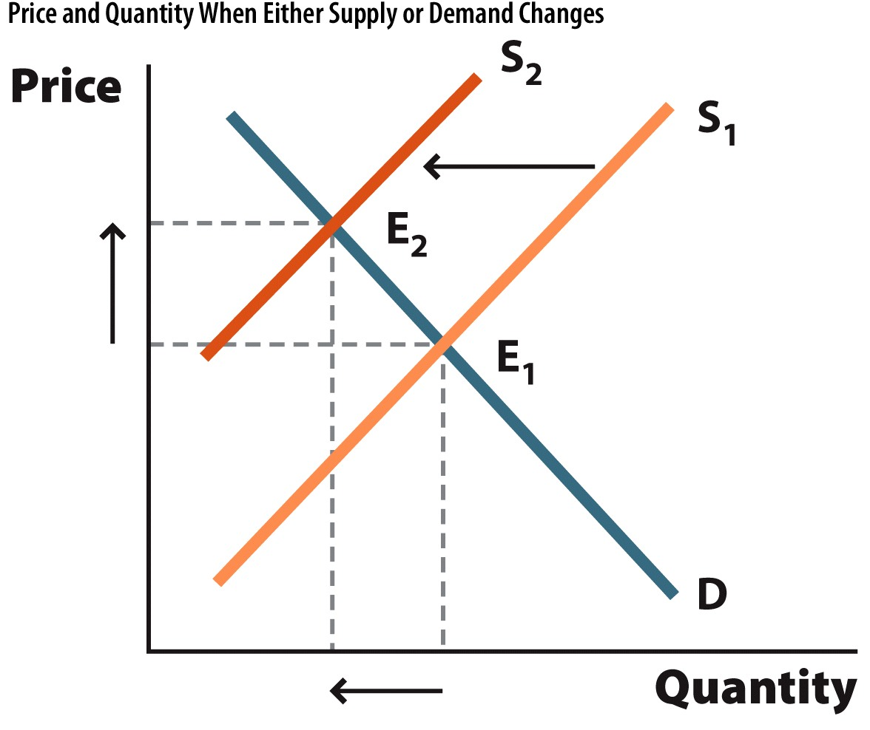
Graphs of Shifts—2
Change | Illustration | Impact on Price and Quantity
Demand decreases |  | The demand curve shifts to the left. As a result, the equilibrium price and equilibrium quantity decrease.
Supply decreases |  | The supply curve shifts to the left. As a result, the equilibrium price increases and the equilibrium quantity decreases.
Notes:
Image: Figure 3.10
Lecture tip:
Go through each of these diagrams thoroughly. For each one, make sure to tell the story of why the equilibrium price changes after the curve shifts. Encourage students to combine these graphs with a list of the factors that could lead to these shifts.
Demand decreases:
The demand curve shifts to the left.
At the initial equilibrium price, a surplus exists.
This puts downward pressure on price.
As price falls, Q_{D} and Q_{S} adjust until we reach the new equilibrium.
Supply decreases:
The supply curve shifts to the left.
At the initial equilibrium price, a shortage exists.
This puts upward pressure on price.
As price rises, Q_{D} and Q_{S} adjust until we reach the new equilibrium.

Slide 60
Economics in Willy Wonka & The Chocolate Factory
Willy Wonka & The Chocolate Factory
  What sort of market effect is happening here? Why is the price of candy bars increasing?
Notes:
“Economics in the Media” Slide
Lecture tip:
The clip mentioned on the slide can be found in the Interactive Instructor’s Guide. Access the direct link by clicking the icon in the PowerPoint.

Slide 61
Conclusion
If you take away just one thing from this course, it will probably be supply and demand
  Powerful tool for explaining market changes
In competitive markets, supply and demand allow prices to adjust toward equilibrium
  This means there are no surpluses or shortages

